Slide 1
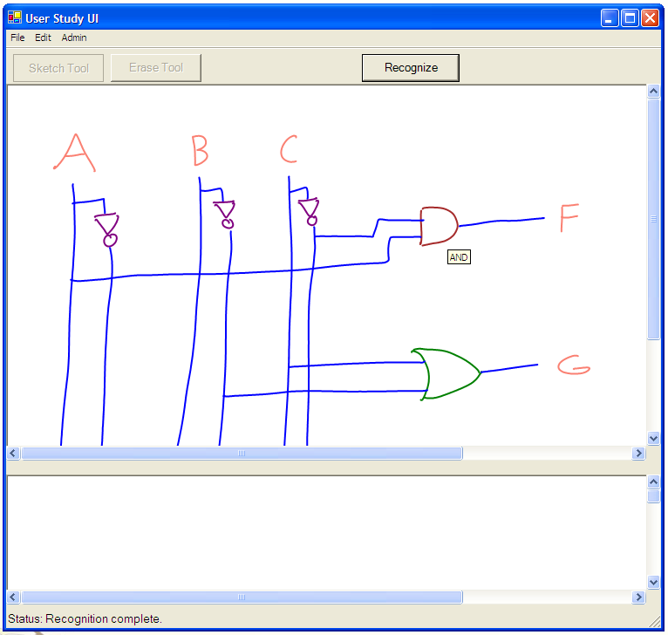
A User Interface for Circuit Design
How do we want our application to look?
To feel?

Slide 2
A Typical Usage Scenario

Slide 3
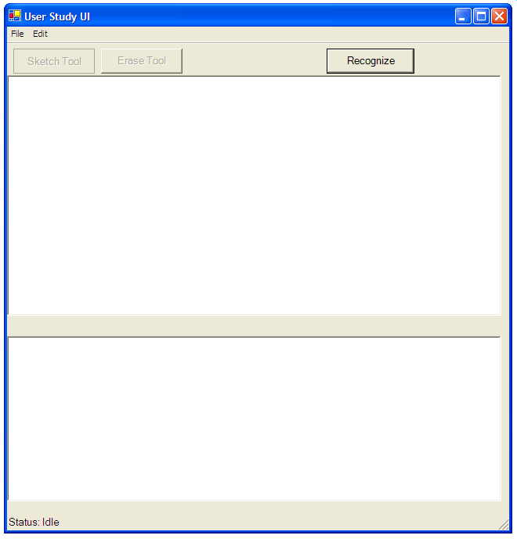

Slide 4
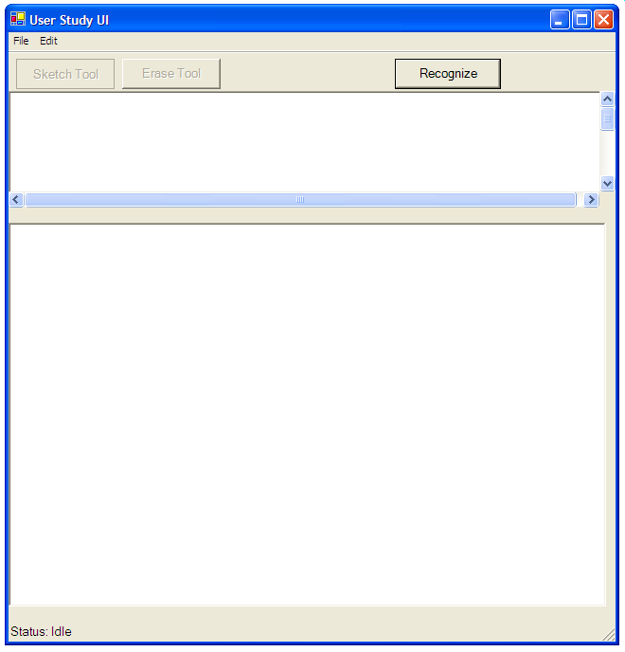

Slide 5
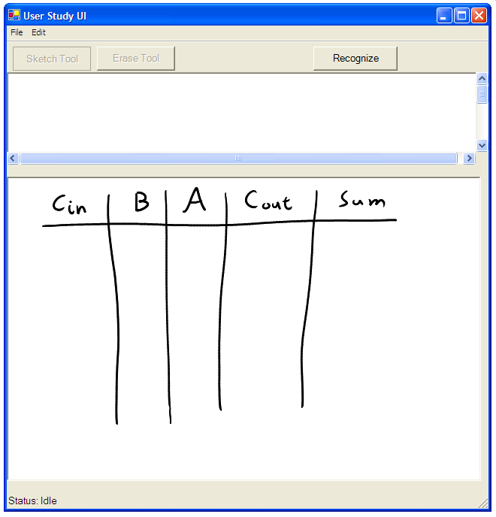

Slide 6
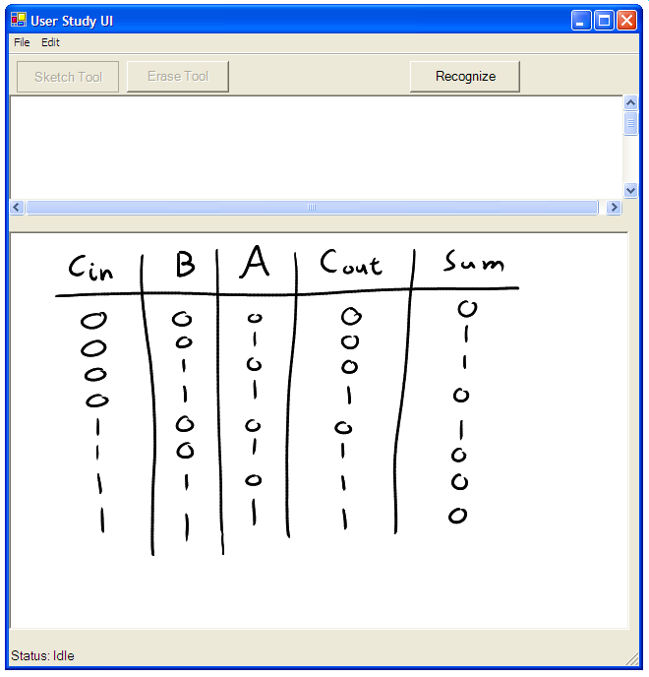

Slide 7
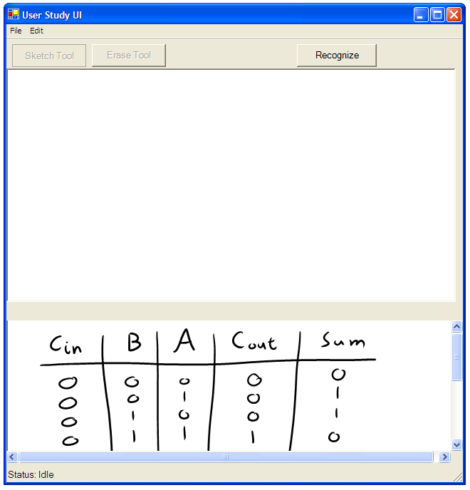

Slide 8
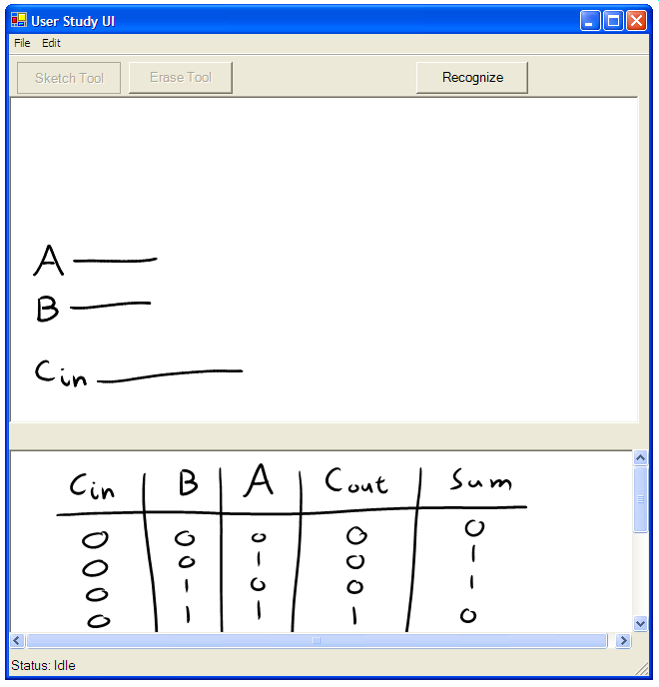

Slide 9
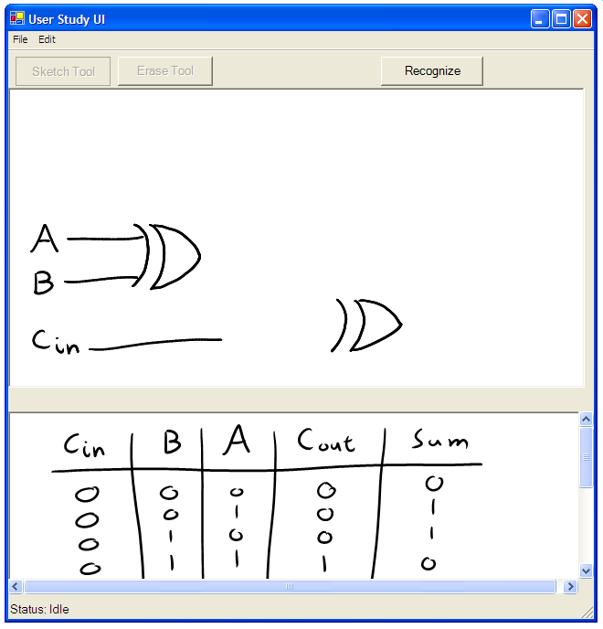

Slide 10
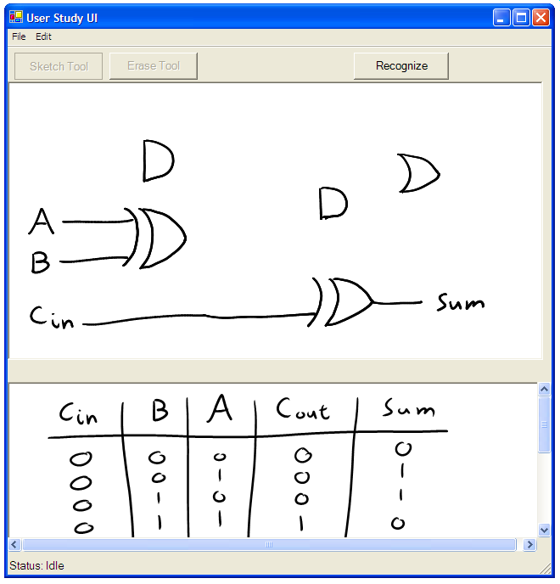

Slide 11
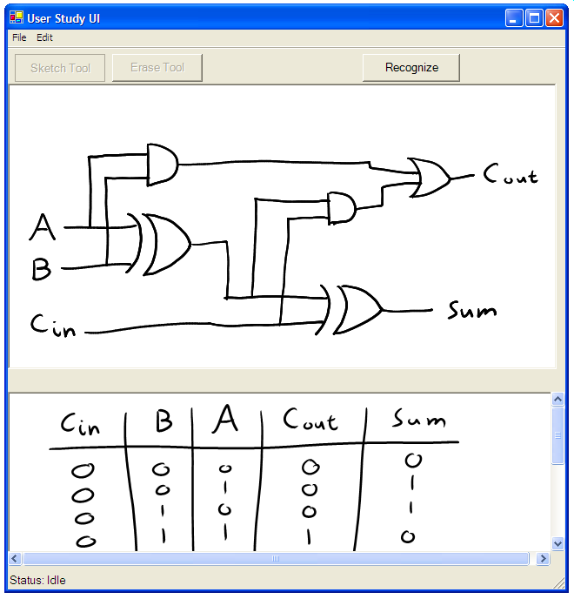

Slide 12
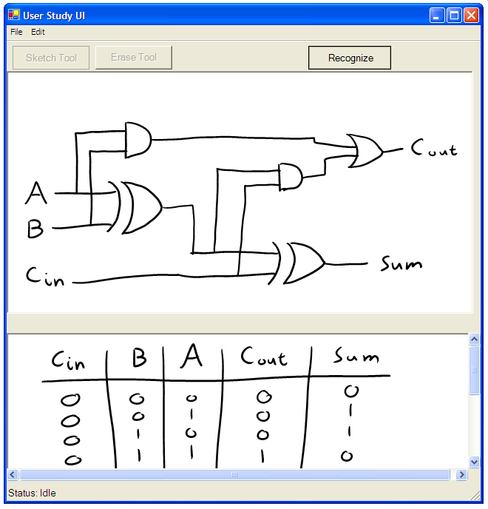

Slide 13
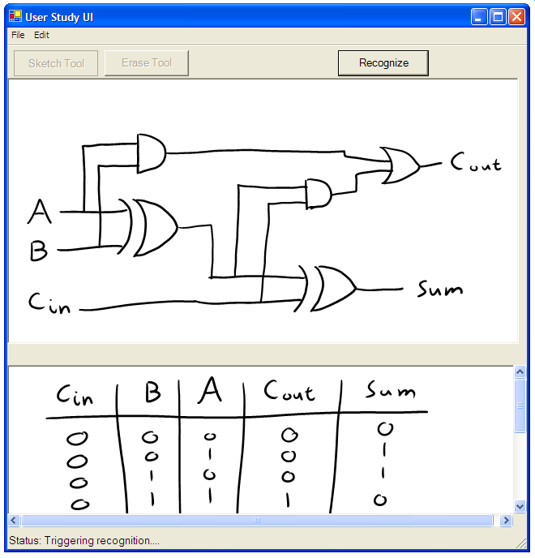

Slide 14
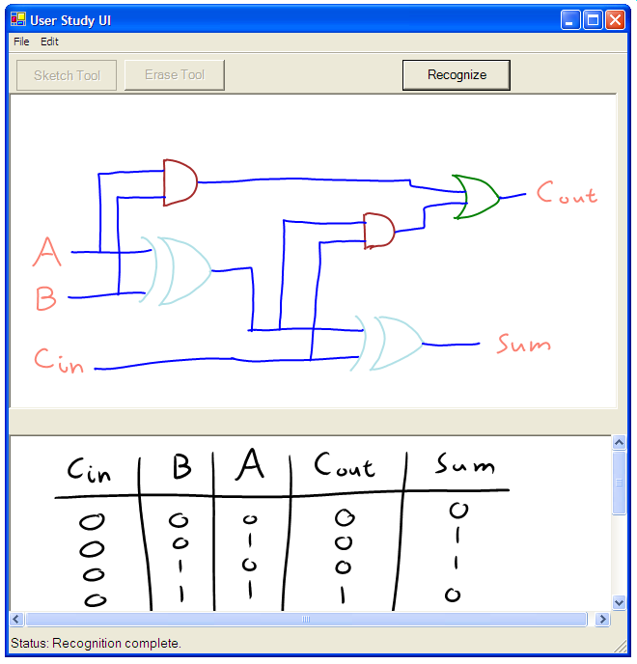

Slide 15
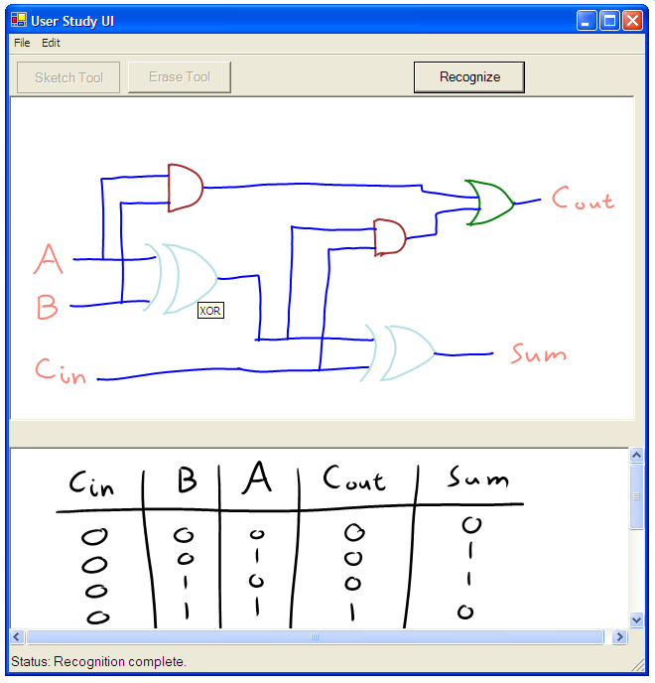

Slide 16
Recognition Triggers
Check-Tap Trigger

Slide 17
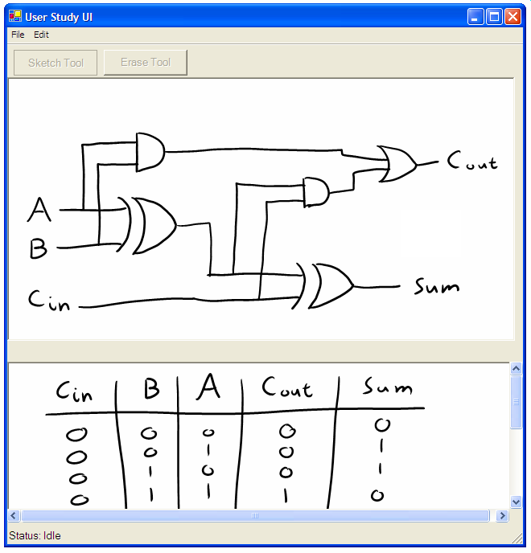

Slide 18
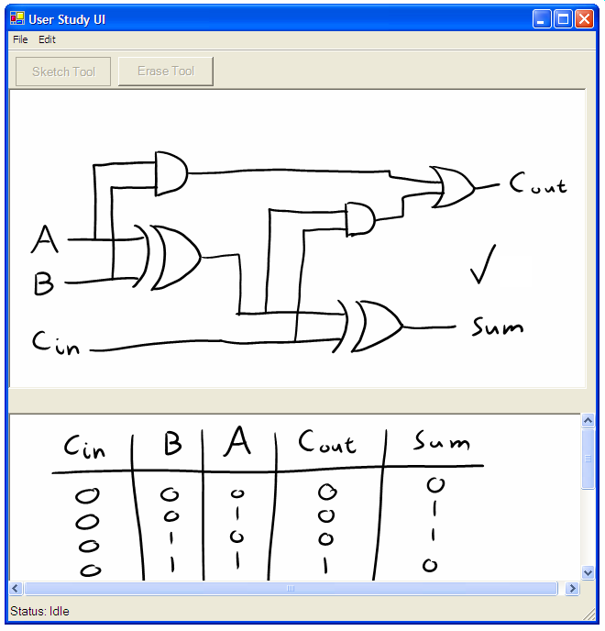

Slide 19


Slide 20
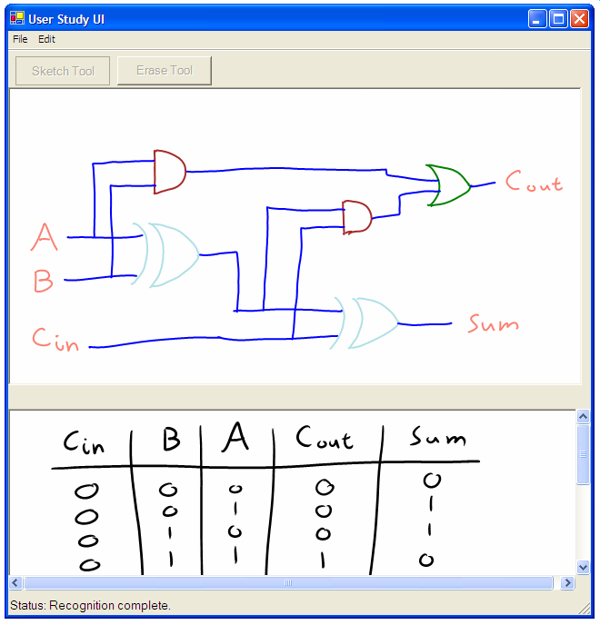

Slide 21
Feedback Mechanisms
Color & Text Label Mechanisms

Slide 23
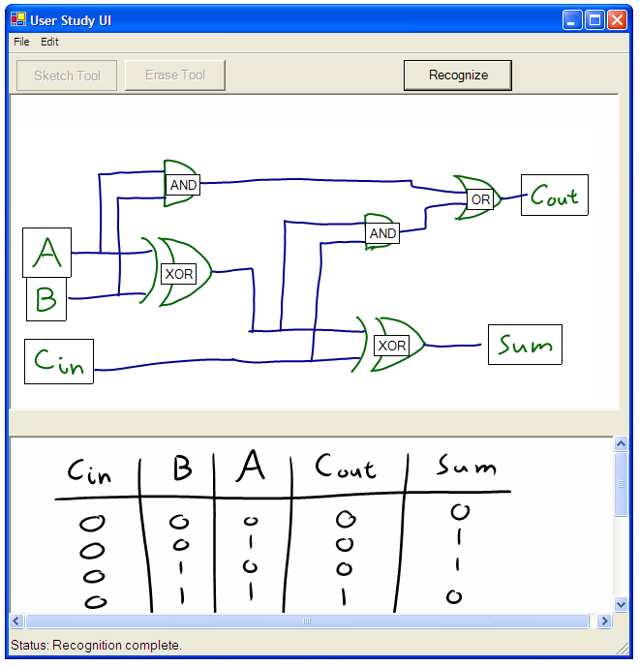

Slide 24
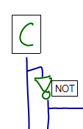



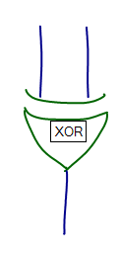

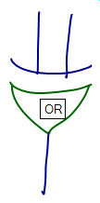
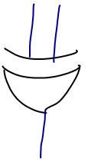
Study of User Interface Elements
Recognition Triggers
Feedback Mechanisms
Error Types
Correct
Mislabel
Grouping Error
Omission

Slide 25
Experimental Design
User Domain Analysis
  Truth table tasks
Observables
  Qualitative user feedback
  Survey results
Task T1
Please draw a circuit diagram for the following truth table:
Inputs |  |  | Outputs
A | B | C | F | G
0 | 0 | 0 | 0 | 0
0 | 0 | 1 | 1 | 0
0 | 1 | 0 | 0 | 1
0 | 1 | 1 | 0 | 0
1 | 0 | 0 | 0 | 0
1 | 0 | 1 | 0 | 0
1 | 1 | 0 | 0 | 1
1 | 1 | 1 | 0 | 0

Slide 26
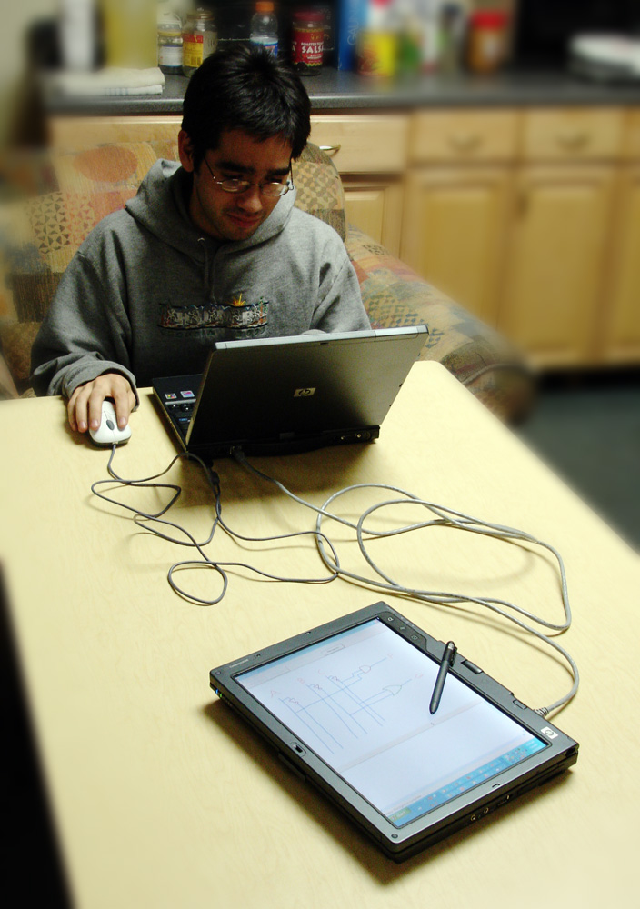
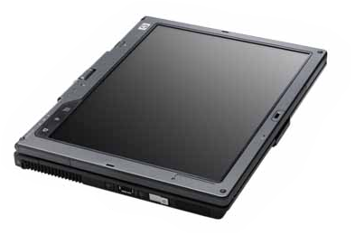
Wizard of Oz Methodology
User Machine
User Draws Circuit
Network
Connection
Wizard Machine
Wizard Simulates
Recognition

Slide 27
Results: Workflow
Write Notes and Equations
8 out of 9 participants
use the same design
workflow
Draw Circuit
Trigger Recognition
Correct Errors
Trigger Recognition Again

Slide 28
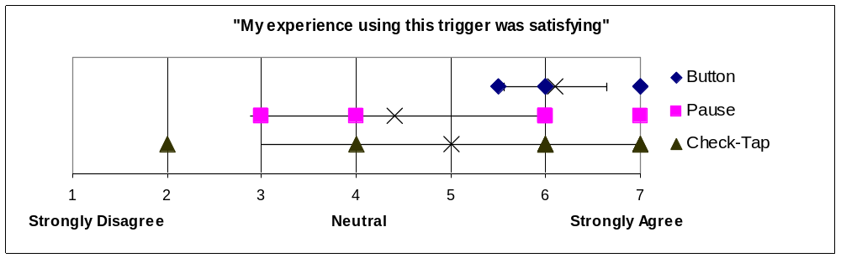
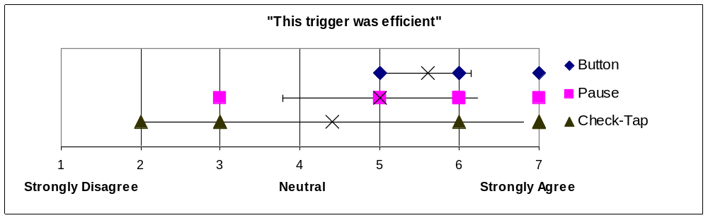
Results: Recognition Triggers
Button Trigger had highest satisfaction
Button Trigger was not necessarily the most efficient trigger

Slide 29
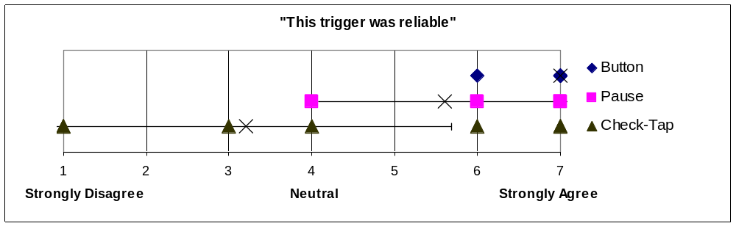
Results: Recognition Triggers
Check-Tap gesture success rate: 1 in 5
Button Trigger reliability contributed to interface efficiency

Slide 30
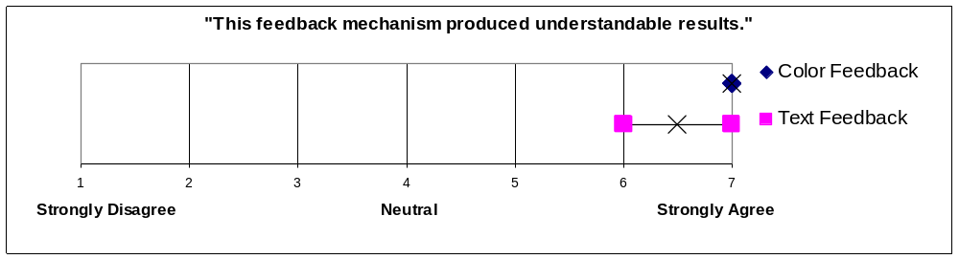
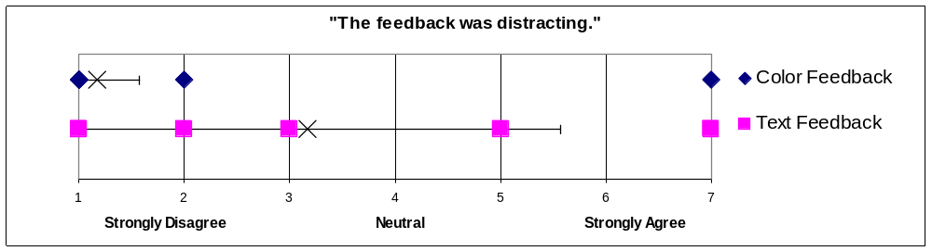
Results: Feedback Mechanisms
Color feedback is slightly more understandable than text.
Text clutters the sketch.
5 of 6 users preferred color feedback to text feedback.
Students mention the learning curve for color feedback is a non-issue
In some cases color feedback made error detection easier

Slide 31
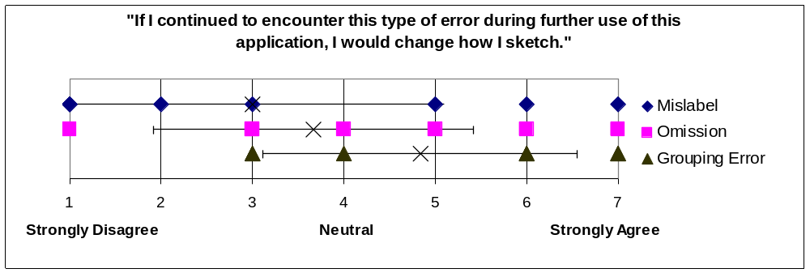
Results: Error Types
Participants tended to see grouping errors as their own fault; mislabel and omission errors were the machine’s fault
4 of 6 users found 15% error rate acceptable; other 2 users would accept the tool of errors were more predictable
Users will accept high error rates if:
  Errors are predictable
  The interface features powerful debugging and correction mechanisms
  Omission error rate is higher than mislabel error rate

